Slide 1
Scoop about scopes
Rémi Forax
Université Gustave Eiffel - June 2023

Slide 2
Rémi Forax ?
Tenured Assistant Prof at Gustave Eiffel University
Expert for Java spec
  invokedynamic, lambda, module, text block, enhanced switch, record, sealed class, etc
OpenSource developer
  ASM, github.com/forax

Slide 3

Don’t believe what I’m saying !

Slide 4
Get an Episode of Rick & Morty
With a blocking call
  static Episode getEpisode(int episodeId) throws IOException, InterruptedException {
  try(var httpClient = HttpClient.newHttpClient()) {
  var request = HttpRequest.newBuilder()
  .uri(URI.create("https://rickandmortyapi.com/api/episode/" + episodeId))
  .GET()
  .build();
  var response = httpClient.send(request, HttpResponse.BodyHandlers.ofInputStream());
  var objectMapper = new ObjectMapper();
  return objectMapper.readValue(response.body(), Episode.class);
  }
  }

Slide 5
Get an Episode of Rick & Morty
With a CompletableFuture
  static CompletableFuture<Episode> getEpisode(int episodeId) {
  try (var httpClient = HttpClient.newHttpClient()) {
  var request = HttpRequest.newBuilder()
  .uri(URI.create("https://rickandmortyapi.com/api/episode/" + episodeId))
  .GET()
  .build();
  return httpClient.sendAsync(request, HttpResponse.BodyHandlers.ofInputStream())
  .thenCompose(response -> {
  var objectMapper = new ObjectMapper();
  Episode episode;
  try {
  episode = objectMapper.readValue(response.body(), Episode.class);
  } catch (IOException e) {
  return CompletableFuture.failedFuture(e);
  }
  return CompletableFuture.completedFuture(episode);
  });
  }
  }
  }

Slide 6
Async/Await
With an asynchronous call + async/await
  static async Episode getEpisode(int episodeId) throws IOException, InterruptedException {
  try(var httpClient = HttpClient.newHttpClient()) {
  var request = HttpRequest.newBuilder()
  .uri(URI.create("https://rickandmortyapi.com/api/episode/" + episodeId))
  .GET()
  .build();
  var response = await httpClient.sendAsync(request, HttpResponse.BodyHandlers.ofInputStream());
  var objectMapper = new ObjectMapper();
  return objectMapper.readValue(response.body(), Episode.class);
  }
  }
made up language: Java + JavaScript

Slide 7
OpenJDK Project Loom
Users write synchronous code, the JDK executes asynchronous calls
Virtual Threads
  JDK Threads that can be attached/detached to/from
  an OS threads
    Preview in Java 19, Final in Java 21

Slide 8
Virtual Threads
  // platform threads
  var pthread = new Thread(() -> {
  System.out.println("platform " + Thread.currentThread());
  });
  pthread.start();
  pthread.join();
  // virtual threads
  var vthread = Thread.startVirtualThread(() -> {
  System.out.println("virtual " + Thread.currentThread());
  });
  vthread.join();

Slide 9
Get an Episode of Rick & Morty
With an asynchronous call + virtual threads
  static Episode getEpisode(int episodeId) throws IOException, InterruptedException {
  try(var httpClient = HttpClient.newHttpClient()) {
  var request = HttpRequest.newBuilder()
  .uri(URI.create("https://rickandmortyapi.com/api/episode/" + episodeId))
  .GET()
  .build();
  var response = httpClient.send(request, HttpResponse.BodyHandlers.ofInputStream());
  var objectMapper = new ObjectMapper();
  return objectMapper.readValue(response.body(), Episode.class);
  }
  }

Slide 10
Behind the scene (1/3)
Virtual threads run on top of platform (OS) threads
virtual threads
Heap
platform threads

Slide 11
Behind the scene (2/3)
Async call: the virtual thread is copied to the heap
virtual threads
Async call
(wait data)
Heap
platform threads

Slide 12
Behind the scene (3/3)
Data are available: the virtual threads is copied back on a stack
Call done
(data available)
virtual threads
Heap
platform threads

Slide 13
How to run several async calls
in parallel ?

Slide 14
ExecutorService API ?
  var executor = Executors.newVirtualThreadPerTaskExecutor();
  var future1 = executor.submit(() -> {
  Thread.sleep(10);
  return ...
  });
  var future2 = executor.submit(() -> {
  Thread.sleep(1_000);
  return ...
  });
  executor.shutdown();
  var result = future1.get() + future2.get();
  System.out.println(result);
Ooooooops

Slide 15
Structured Concurrency
Structured programming for concurrency
  Structured code (goto is harmful)
    if, while, etc are better than goto
  ExecutorService.submit() is like a goto !

Slide 16

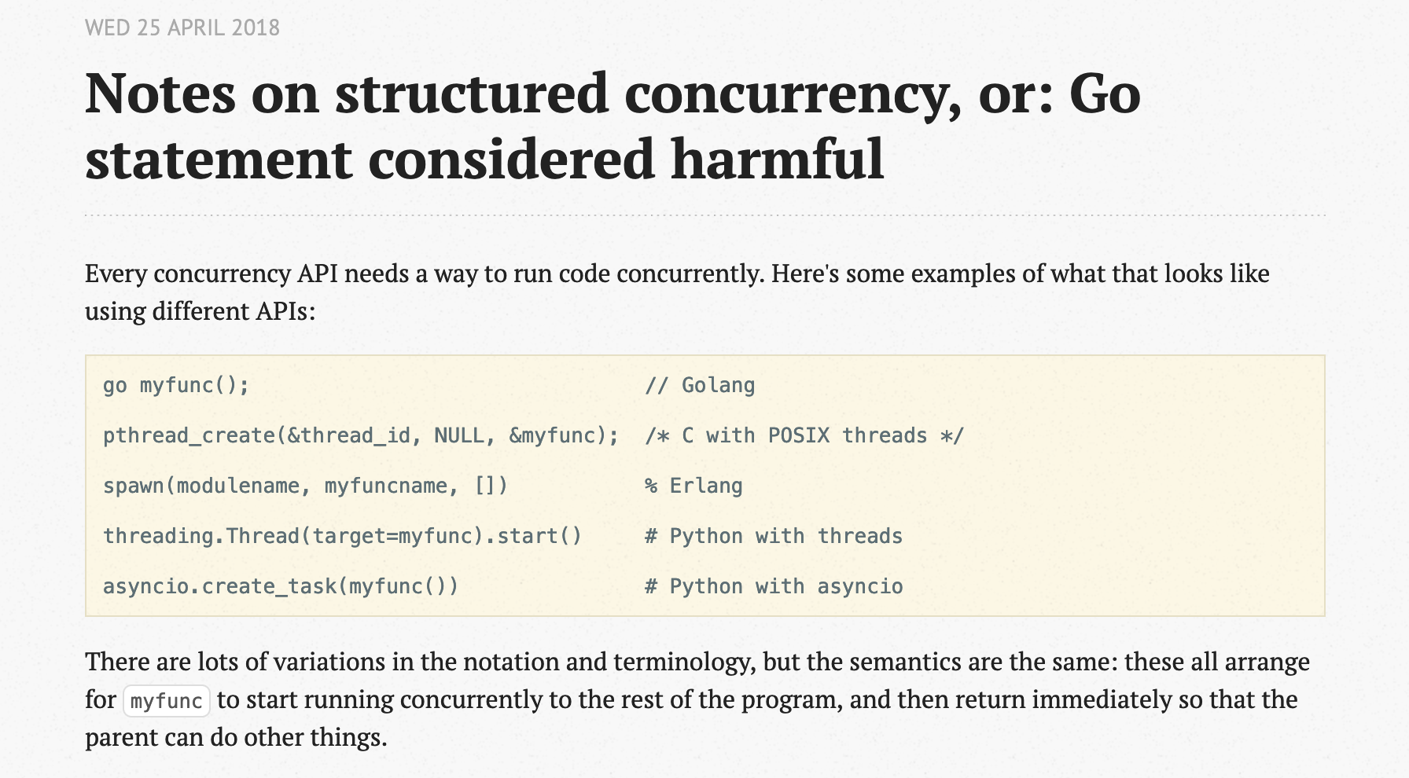
Nathaniel J. Smith
https://vorpus.org/blog/notes-on-structured-concurrency-or-go-statement-considered-harmful/

Slide 17
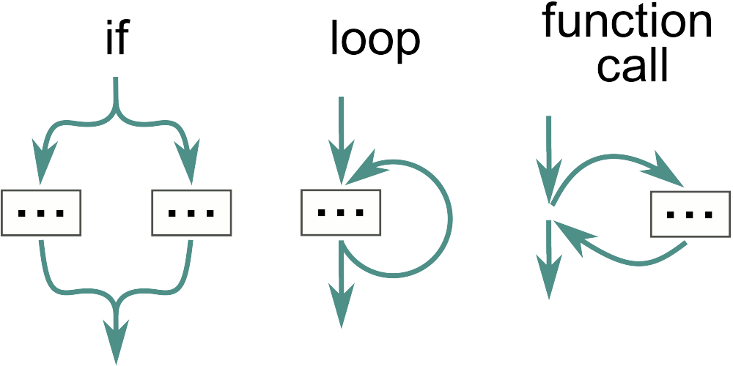
Structured Concurrency
Structured programming for concurrency
  Structured code (goto is harmful)
    if, while, function calls, etc are better than goto

Slide 18
Structured Concurrency
  Is ExecutorService.submit()/Future.get() a goto ?
  Change in Java 19
    ExecutorService now implements AutoClosable
    try(var executor = …) {
    var future = executor.submit(() - > { … });
    var future2 = executor.submit(() - > { … });
    ...
    } // all threads are dead here

Slide 19
Structured Concurrency
Parent/child relationship between a task and its subtasks
  No runaway threads
    all threads have finished at the end
  No ignored exceptions
    exceptions are not be swept under the rug

Slide 20
StructuredTaskScope
run several async calls in parallel
(preview feature in Java 21)

Slide 21
StructuredTaskScope
  try(var sts = new StructuredTaskScope<...>()) {
  … // starts threads
  sts.join(); // wait for all threads
  … // collect results
  } // clean threads

Slide 22
Example of StructuredTaskScope
  try(var sts = new StructuredTaskScope<Integer>()) {
  var task = sts.fork(() -> 3);
  var task2 = sts.fork(() -> 42);
  sts.join();
  var result = task.get() + task2.get();
  }

Slide 23
Big Picture
As a user, it’s two levels of API
  Primary API (STS)
    try(var sts = new STS<...>()) { ...
    sts.join()
  Secondary API (Subtask)
    Subtask<...> task = sts.fork(…)
    task.state(), task.get() or task.exception()
SUCCESS, FAILED, UNAVAILABLE

Slide 24
STS and STS subclasses
StructuredTaskScope offers two subclasses
  STS.ShutdownOnSuccess(), stop when one task succeed
  STS.ShutdownOnFailure(), stop if one task failed
StructuredTaskScope can also be inherited
  class MySTS extends STS<Integer> {
  // called concurrently by all threads after completion
  public void handleComplete(Task<? extends Integer> task) {
  task.state() // only SUCCESS or FAILED
  ...
  }
  }

Slide 25
Demo

Slide 26
ShutdownOnSuccess
The result is available on the STS
  int value;
  try(var sts = new STS.ShutdownOnSuccess<Integer>()) {
  sts.fork(() - > …);
  sts.fork(() - > …);
  value = sts.join()
  .result(); // T or throws ExecutionException
  }

Slide 27
ShutdownOnFailure
The exception is available on the STS
  int result;
  try(var sts = new STS.ShutdownOnFailure()) {
  var task1 = sts.fork(() - > …);
  var task2 = sts.fork(() - > …)
  sts.join()
  .throwIfFailed(); // may throw ExecutionException
  result = task1.get() + task2.get();
  }

Slide 28
Timeout
try (var scope = new StructuredTaskScope<>()) {
var task1 = scope.fork(() →...);
var task2 = scope.fork(() -> ...);
try {
scope.joinUntil(Instant.now().plus(Duration.ofMillis(100)));
} catch (TimeoutException e) {
...
}
System.out.println(task1.state()); // may be UNAVAILABLE if timeout
System.out.println(task2.state()); // may be UNAVAILABLE if timeout
}

Slide 29
Iteratively improve the API
(for Java 22 ??)

Slide 30
STS API Issues for me
Issues I would like to fix:
  ShutdownOnXXX can be misused if throwIfFailed()/result() are not used
  Exceptions are erased to Throwable and wrapped
  STS.handleComplete(Subtask<...>) is too dangerous !
    Also SubTask states are different inside/outside of handleComplete()

Slide 31
Demo

Slide 32
STSShutdownOnSuccess
fork() returns void, exceptions are propagated by joinAll()
  try (var scope =
  new STSShutdownOnSuccess<Integer, RuntimeException>()) {
  scope.fork(() -> ...);
  scope.fork(() ->…);
  var result = scope.joinAll(); // Integer or throws RuntimeException
  System.out.println(result);
  }

Slide 33
STSShutdownOnFailure
Subtasks are typed by the return values, scope by the exception
  try (var scope =
  new STSShutdownOnFailure<IOException>()) {
  Subtask<Integer> task1 = scope.fork(...);
  Subtask<Integer> task2 = scope.fork(...);
  scope.joinAll(); // may throw IOException
  System.out.println(task1.get() + task2.get());
  }

Slide 34
STSAsStream
joinAll() provides a stream of the finished tasks (Result)
  try (var scope = new STSAsStream<Integer, IOException>()) {
  var task1 = scope.fork(...);
  var task2 = scope.fork(...);
  List<Result<Integer,IOException>> list =
  scope.joinAll(stream -> stream.toList());
  System.out.println(list);
  }
Result<T,E> acts as an union: Success(T) | Failed(E)

Slide 35
STSAsStream short circuit
If the stream finished, tasks still running are cancelled
  try (var scope = new STSAsStream<Integer, IOException>()) {
  var task1 = scope.fork(...);
  var task2 = scope.fork(...);
  Optional<Integer> optional =
  scope.joinAll(s -> s.flatMap(Result::keepOnlySuccess).findFirst());
  System.out.println(optional);
  }

Slide 36
Executive Summary

Slide 37
Summary
Structured concurrency idea is cool
  JEP 453: Structured Concurrency
    https://openjdk.org/jeps/453
  and in the future (maybe?)
  https://github.com/forax/loom-fiber/tree/java21

